Slide 1
Database design and Applications CSIZG518/SEZG518/SSZG518)(S1-21) Ms. Uma Maheswari

Slide 2
Session
Topic: Logical design – Normalization

Slide 3
LEARNING OUTCOME
Guidelines for database design
Functional dependencies
Normal forms and their conditions
Decomposition and properties
REFER:
T1-Chapter 10 and 11
Sections:
10.1-10.5 and 11.1

Slide 4
Guidelines for database design

Slide 5
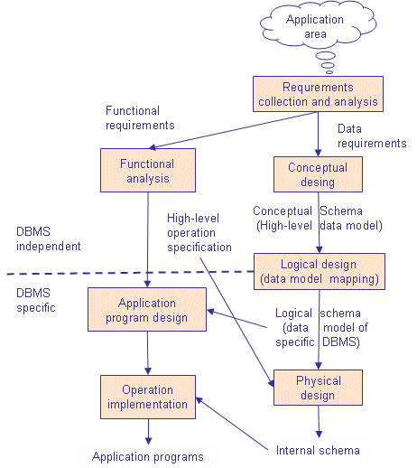
Guidance on DB design

Slide 6
Phases of Information System Life Cycle

Slide 7
Phases of Information System Life Cycle

Slide 8

Database System Life Cycle

Slide 9
Database Design and Implementation

Slide 10
Database Design and Implementation

Slide 11
Schema Design

Slide 12
Schema Design

Slide 13
Schema Design

Slide 14
Schema Design

Slide 15
Schema Design

Slide 16
Transaction Design

Slide 17
DB Design

Slide 18
DB design and Tuning
Unified Modeling Language (UML) is a general purpose modelling language. The main aim of UML is to define a standard way to visualize the way a system has been designed. It is quite similar to blueprints used in other fields of engineering.
UML is not a programming language, it is rather a visual language. We use UML diagrams to portray the behavior and structure of a system.
UML helps software engineers, businessmen and system architects with modelling, design and analysis.
The Object Management Group (OMG) adopted Unified Modelling Language as a standard in 1997. Its been managed by OMG ever since.
International Organization for Standardization (ISO) published UML as an approved standard in 2005. UML has been revised over the years and is reviewed periodically.

Slide 19
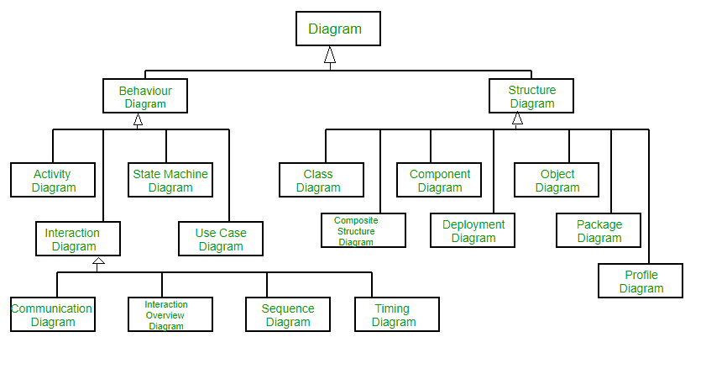
UML

Slide 20
UML usecase

Slide 21
UML Sequence diagrams

Slide 22
UML Statechart diagrams

Slide 23
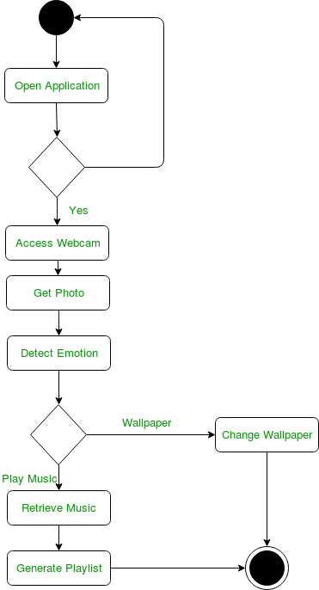
UML Activity Diagrams

Slide 24
UML tool

Slide 25
Relational Rose

Slide 26
DB design tools: Relational Rose

Slide 27
DB design tools:

Slide 28
FUNCTIONAL DEPENDENCIES

Slide 29
FD
What is a functional dependency?
Functional Dependency is when one attribute determines another attribute in a DBMS system. Functional Dependency plays a vital role to find the difference between good and bad database design.
Example:
By this, we can say that the city, Employee Name, and salary are functionally depended on Employee number.
A functional dependency is denoted by an arrow →
The functional dependency of X on Y is represented
by X →Y
if we know the value of Employee number, we can obtain Employee Name, city, salary, etc.
Employee number | Employee Name | Salary | City
1 | Dana | 50000 | San Francisco
2 | Francis | 38000 | London
3 | Andrew | 25000 | Tokyo

Slide 30
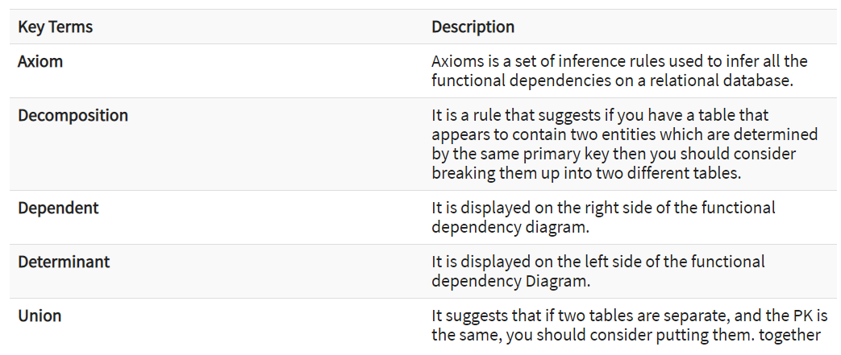
FD
some key terms for functional dependency:

Slide 31
FD rules
Rules of Functional Dependencies
Below given are the 3 most important rules for Functional Dependency:
Reflexive rule –. If X is a set of attributes and Y is_subset_of X, then X holds a value of Y.
Augmentation rule: When x -> y holds, and c is attribute set, then ac -> bc also holds. That is adding attributes which do not change the basic dependencies.
Transitivity rule: This rule is very much similar to the transitive rule in algebra if x -> y holds and y -> z holds, then x -> z also holds. X -> y is called as functionally that determines y.

Slide 32
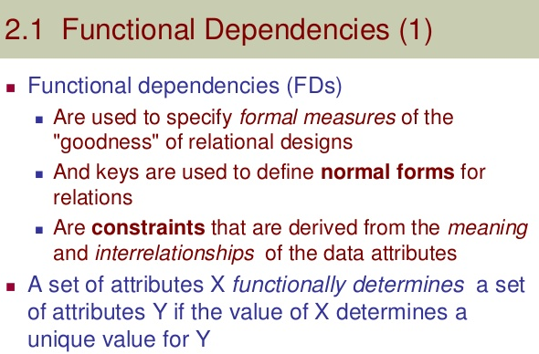
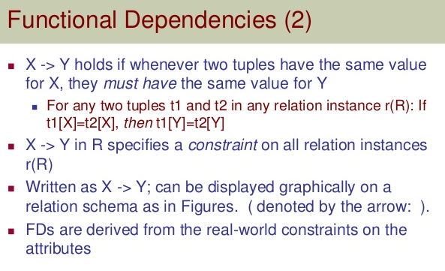
Functional dependencies

Slide 33
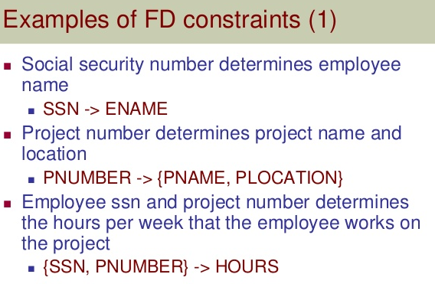
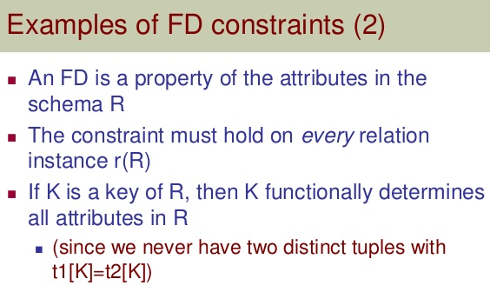
Functional dependencies

Slide 34
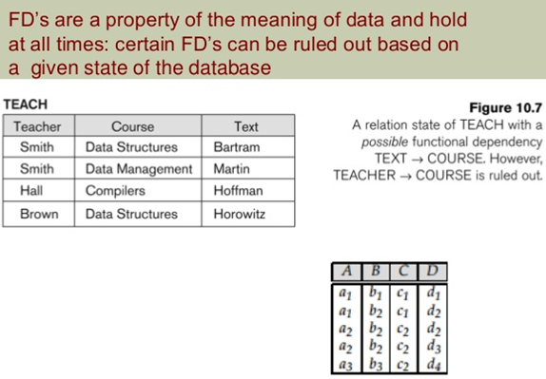
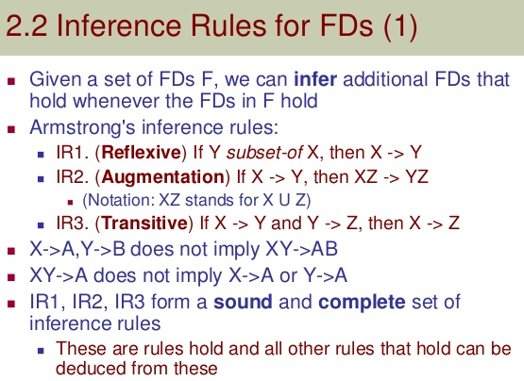
Functional dependencies

Slide 35
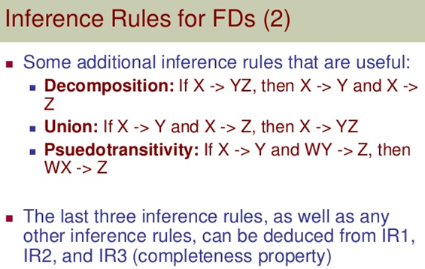
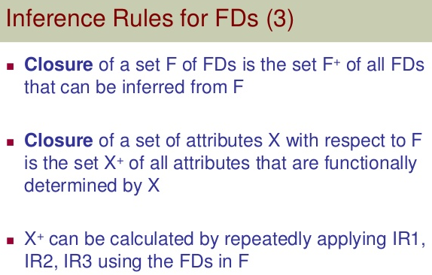
Functional dependency

Slide 36
Functional dependency

Slide 37
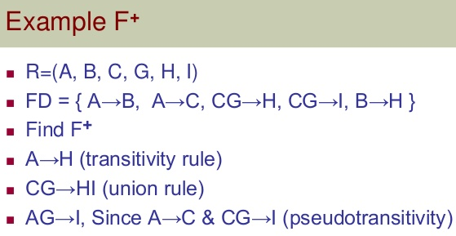
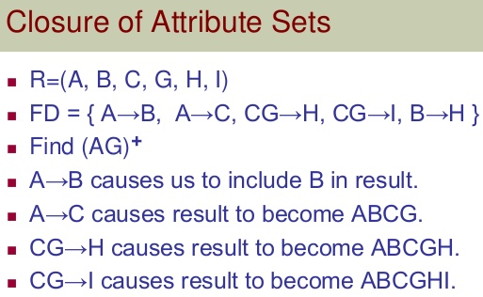
Closure

Slide 38
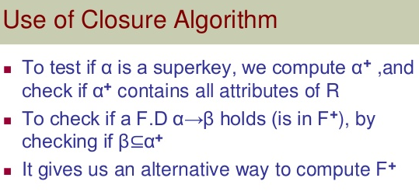
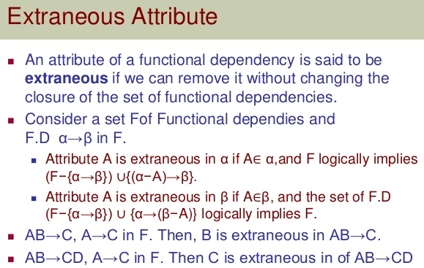
Functional dependency

Slide 39
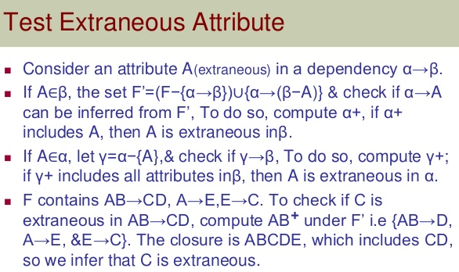
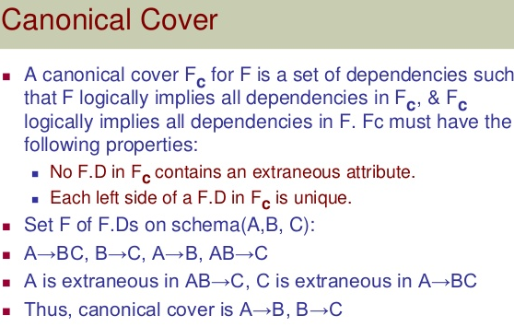
Functional dependency: Canonical Cover

Slide 40
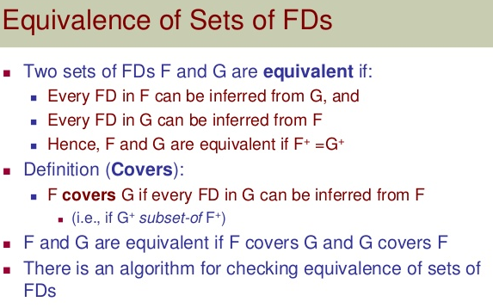
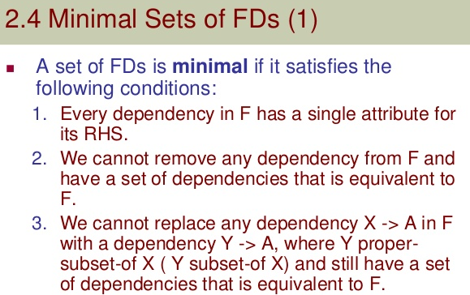
Functional dependency

Slide 41
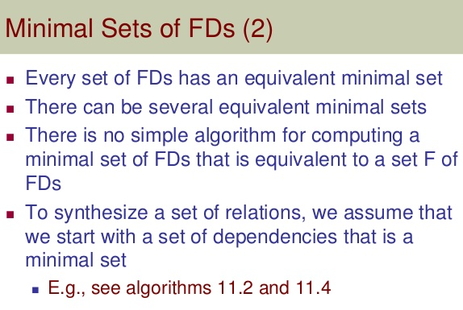
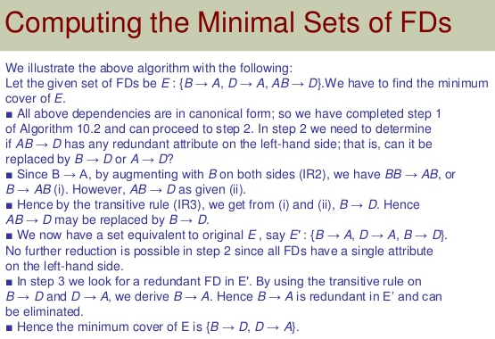
Functional dependency

Slide 42
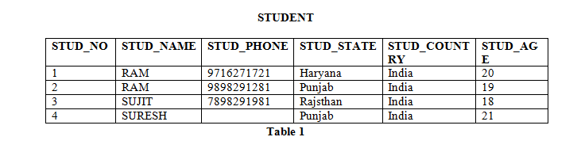
EXAMPLE:
A functional dependency A->B in a relation holds if two tuples having same value of attribute A also have same value for attribute B.
For Example, in STUDENT relation
STUD_NO->STUD_NAME, STUD_NO->STUD_ADDR
holds in STUDENT
But STUD_NAME->STUD_ADDR do not hold
Consider the STUDENT relation given in Table 1.
We know that STUD_NO is unique for each student. So STUD_NO->STUD_NAME, STUD_NO->STUD_PHONE, STUD_NO->STUD_STATE, STUD_NO->STUD_COUNTRY and STUD_NO -> STUD_AGE all will be true.
Similarly, STUD_STATE->STUD_COUNTRY will be true as if two records have same STUD_STATE, they will have same STUD_COUNTRY as well.
For relation STUDENT_COURSE, COURSE_NO->COURSE_NAME will be true as two records with same COURSE_NO will have same COURSE_NAME.

Slide 43
Types of Functional Dependencies
Multivalued dependency occurs in the situation where there are multiple independent multivalued attributes in a single table. A multivalued dependency is a complete constraint between two sets of attributes in a relation. It requires that certain tuples be present in a relation.
Car_model | Maf_year | Color
H001 | 2017 | Metallic
H001 | 2017 | Green
H005 | 2018 | Metallic
H005 | 2018 | Blue
H010 | 2015 | Metallic
H033 | 2012 | Gray
Maf_year and color are independent of each other but dependent on car_model.
In this example, these two columns are said to be multivalue dependent on car_model.
This dependence can be represented like this:
car_model -> maf_year
car_model-> colour

Slide 44
Types of Functional Dependencies
Trivial dependency is a set of attributes which are called a trivial if the set of attributes are included in that attribute.
So, X -> Y is a trivial functional dependency if Y is a subset of X.
Ie., {X,Y} ->X
The following dependencies are also trivial: X->X & Y->Y.
Emp_id | Emp_name
AS555 | Harry
AS811 | George
AS999 | Kevin
Consider this table with two columns Emp_id and Emp_name.
{Emp_id, Emp_name} -> Emp_id is a trivial functional dependency as Emp_id is a subset of {Emp_id,Emp_name}.

Slide 45
Types of Functional Dependencies
Non-trivial functional dependency
Functional dependency which also known as a nontrivial dependency occurs when A->B holds true where B is not a subset of A. In a relationship, if attribute B is not a subset of attribute A, then it is considered as a non-trivial dependency.
Company | CEO | Age
Microsoft | Satya Nadella | 51
Google | Sundar Pichai | 46
Apple | Tim Cook | 57
Example:
(Company} -> {CEO} (if we know the Company, we know the CEO name)
But CEO is not a subset of Company, and hence it's non-trivial functional dependency.

Slide 46
Types of Functional Dependencies
A transitive dependency is a type of functional dependency which happens when t is indirectly formed by two functional dependencies.
{Company} -> {CEO} (if we know the compay, we know its CEO's name)
{CEO } -> {Age} If we know the CEO, we know the Age
Therefore according to the rule of rule of transitive dependency:
{ Company} -> {Age} should hold, that makes sense because if we know the company name, we can know his age.
Note: You need to remember that transitive dependency can only occur in a relation of three or more attributes.
Company | CEO | Age
Microsoft | Satya Nadella | 51
Google | Sundar Pichai | 46
Alibaba | Jack Ma | 54

Slide 47
FD
Advantages of Functional Dependency
Functional Dependency avoids data redundancy. Therefore same data do not repeat at multiple locations in that database
It helps you to maintain the quality of data in the database
It helps you to defined meanings and constraints of databases
It helps you to identify bad designs
It helps you to find the facts regarding the database design

Slide 48
Keys and Key Attributes

Slide 49
Keys and Attributes Participating in Keys
Superkey : A set of attributes of a relation that will have values unique to each tuple.
Key : A minimal superkey; removing any attribute will eliminate the uniqueness property.
Candidate Key : If a relation schema has more than one key, all possibilities are called candidate keys.
Primary Key : One candidate key chosen to be primary; by default this is the target of any foreign key references into its relation.
Prime Attribute : An attribute of a relation that is a member of any candidate key.
Nonprime Attribute : An attribute of a relation that isn't a prime attribute

Slide 50
Keys and Attributes Participating in Keys
A superkey
Its a group of single or multiple keys which identifies rows in a table.
A Super key may have additional attributes that are not needed for unique identification.
EmpSSN | EmpNum | Empname
9812345098 | AB05 | Shown
9876512345 | AB06 | Roslyn
199937890 | AB07 | James
EmpSSN and EmpNum name are superkeys.

Slide 51
Keys and Attributes Participating in Keys
PRIMARY KEY:
A column or group of columns in a table which helps us to uniquely identifies every row in that table is called a primary key. This DBMS can't be a duplicate. The same value can't appear more than once in the table.
Rules for defining Primary key:
Two rows can't have the same primary key value
It is a must for every row to have a primary key value.
The primary key field cannot be null.
The value in a primary key column can never be modified or updated if any foreign key refers to that primary key.
StudID | Roll No | First Name | LastName | Email
1 | 11 | Tom | Price | abc@gmail.com
2 | 12 | Nick | Wright | xyz@gmail.com
3 | 13 | Dana | Natan | mno@yahoo.com
StudID is a Primary Key.

Slide 52
Keys and Attributes Participating in Keys
Alternate key:
All the keys which are not primary key are called an alternate key.
It is a candidate key which is currently not the primary key.
However, A table may have single or multiple choices for the primary key.
StudID, Roll No, Email are qualified to become a primary key. But since StudID is the primary key, Roll No, Email becomes the alternative key.
StudID | Roll No | First Name | LastName | Email
1 | 11 | Tom | Price | abc@gmail.com
2 | 12 | Nick | Wright | xyz@gmail.com
3 | 13 | Dana | Natan | mno@yahoo.com

Slide 53
Keys and Attributes Participating in Keys
Candidate Key:
A super key with no repeated attribute is called candidate key.
The Primary key should be selected from the candidate keys. Every table must have at least a single candidate key.
Properties of Candidate key:
It must contain unique values
Candidate key may have multiple attributes
Must not contain null values
It should contain minimum fields to ensure uniqueness
Uniquely identify each record in a table
In the given table Stud ID, Roll No, and email are candidate keys which help us to uniquely identify the student record in the table.
StudID | Roll No | First Name | LastName | Email
1 | 11 | Tom | Price | abc@gmail.com
2 | 12 | Nick | Wright | xyz@gmail.com
3 | 13 | Dana | Natan | mno@yahoo.com

Slide 54
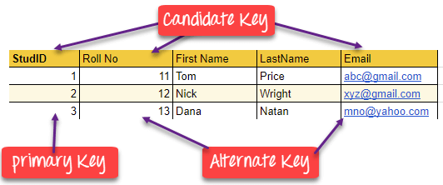
Keys and Attributes Participating in Keys

Slide 55
Keys and Attributes Participating in Keys
Foreign Key:
A foreign key is a column which is added to create a relationship with another table.
Foreign keys help us to maintain data integrity and also allows navigation between two different instances of an entity.
Every relationship in the model needs to be supported by a foreign key.
we have two table, teach and department in a school. However, there is no way to see which search work in which department.
department
In this table, adding the foreign key in Deptcode to the Teacher name, we can create a relationship between the two tables.
DeptCode | DeptName
001 | Science
002 | English
005 | Computer
Teacher ID | DeptCode | Fname | Lname
B002 | 002 | David | Warner
B017 | 002 | Sara | Joseph
B009 | 001 | Mike | Brunton
teach
Teacher ID | Fname | Lname
B002 | David | Warner
B017 | Sara | Joseph
B009 | Mike | Brunton
This concept is also known as Referential Integrity.

Slide 56
Keys and Attributes Participating in Keys
Compound key:
It has many fields which allow you to uniquely recognize a specific record.
It is possible that each column may be not unique by itself within the database.
However, when combined with the other column or columns the combination of composite keys become unique.
OrderNo | PorductID | Product Name | Quantity
B005 | JAP102459 | Mouse | 5
B005 | DKT321573 | USB | 10
B005 | OMG446789 | LCD Monitor | 20
B004 | DKT321573 | USB | 15
B002 | OMG446789 | Laser Printer | 3
OrderNo and ProductID can't be a primary key as it does not uniquely identify a record. However, a compound key of Order ID and Product ID could be used as it uniquely identified each record.

Slide 57
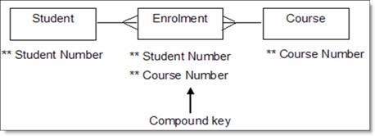
Keys and Attributes Participating in Keys
A compound key consists of more than one attribute to uniquely identify an entity occurrence.
Each attribute, which makes up the key, is also a simple key in its own right.
For example, we have an entity named enrolment, which holds the courses on which a student is enrolled. In this scenario a student is allowed to enrol on more than one course. This has a compound key of both student number and course number, which is required to uniquely identify a student on a particular course.
Student number and course number combined is a compound primary key for the enrolment entity.

Slide 58
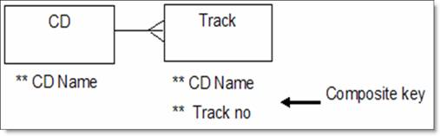
Keys and Attributes Participating in Keys
Composite key:
A key which has multiple attributes to uniquely identify rows in a table is called a composite key.
The difference between compound and the composite key is that any part of the compound key
can be a foreign key, but the composite key may or maybe not a part of the foreign key.
For example, you have a database holding your CD collection. One of the entities is called tracks, which holds details of the tracks on a CD. This has a composite key of CD name, track number.
CD name in the track entity is a simple key, linking to the CD entity, but track number is not a simple key in its own right.

Slide 59
Keys and Attributes Participating in Keys
Surrogate Key:
An artificial key which aims to uniquely identify each record is called a surrogate key.
These kind of key are unique because they are created when you don't have any natural primary key.
They do not lend any meaning to the data in the table. Surrogate key is usually an integer.
Fname | Lastname | Start Time | End Time
Anne | Smith | 09:00 | 18:00
Jack | Francis | 08:00 | 17:00
Anna | McLean | 11:00 | 20:00
Shown | Willam | 14:00 | 23:00
Above, given example, shown shift timings of the different employee. In this example, a surrogate key is needed to uniquely identify each employee.
Surrogate keys are allowed when
No property has the parameter of the primary key.
In the table when the primary key is too big or complicated.

Slide 60
NORMALIZATION

Slide 61
Normalization
What is Normalization?
Normalization is a method of organizing the data in the database which helps you to avoid data redundancy, insertion, update & deletion anomaly. It is a process of analyzing the relation schemas based on their different functional dependencies and primary key.
Normalization is inherent to relational database theory. It may have the effect of duplicating the same data within the database which may result in the creation of additional tables.

Slide 62
Problem Without Normalization
Without Normalization, it becomes difficult to handle and update the database, without facing data loss. Insertion, Updation and Deletion Anamolies are very frequent if Database is not Normalized
S_id | S_Name | S_Address | Subject_opted
401 | Adam | Noida | Bio
402 | Alex | Panipat | Maths
403 | Stuart | Jammu | Maths
404 | Adam | Noida | Physics

Slide 63
Problem Without Normalization
Updation Anamoly : To update address of a student who occurs twice or more than twice in a table, we will have to update S_Address column in all the rows, else data will become inconsistent.
Insertion Anamoly : Suppose for a new admission, we have a Student id(S_id), name and address of a student but if student has not opted for any subjects yet then we have to insert NULL there, leading to Insertion Anamoly.
Deletion Anamoly : If (S_id) 401 has only one subject and temporarily he drops it, when we delete that row, entire student record will be deleted along with it.

Slide 64
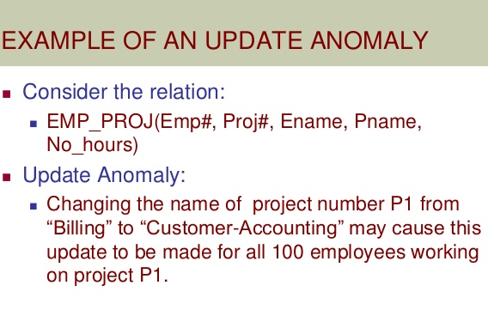
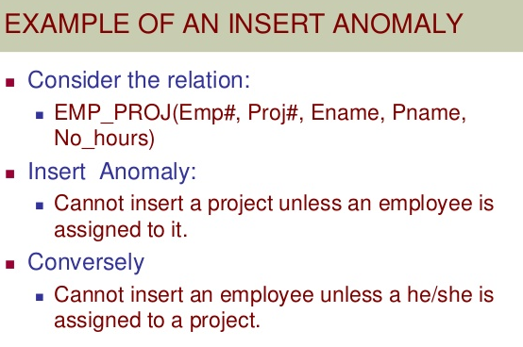
Anomalies

Slide 65
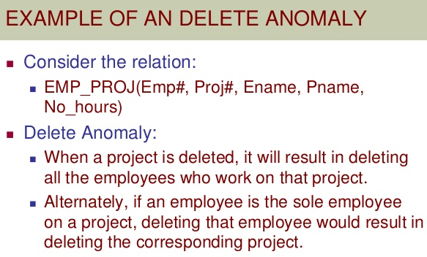
Anomalies

Slide 66
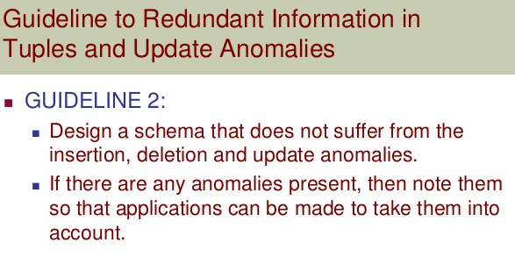
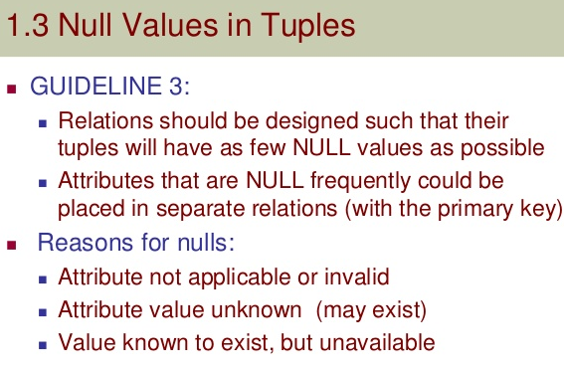
Redundancy

Slide 67
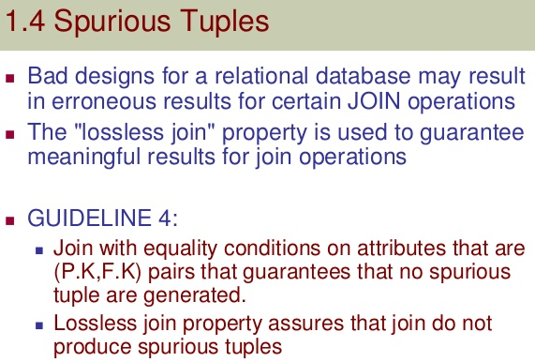
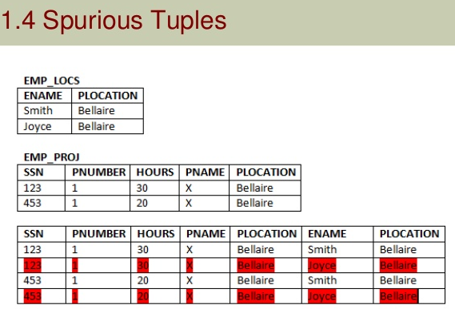
Spurious tuples

Slide 68
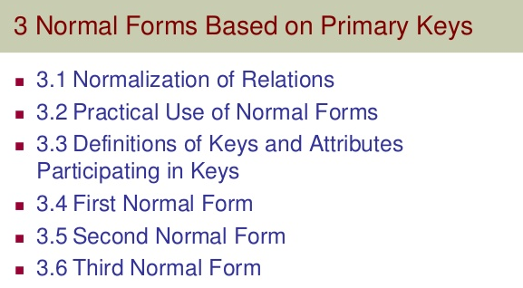
Normalization

Slide 69
NORMAL FORMS
Normal Form | Description
1NF | A relation is in 1NF if it contains an atomic value.
2NF | A relation will be in 2NF if it is in 1NF and all non-key attributes are fully functional dependent on the primary key.
3NF | A relation will be in 3NF if it is in 2NF and no transition dependency exists.
4NF | A relation will be in 4NF if it is in Boyce Codd normal form and has no multi-valued dependency.
5NF | A relation is in 5NF if it is in 4NF and not contains any join dependency and joining should be lossless.

Slide 70
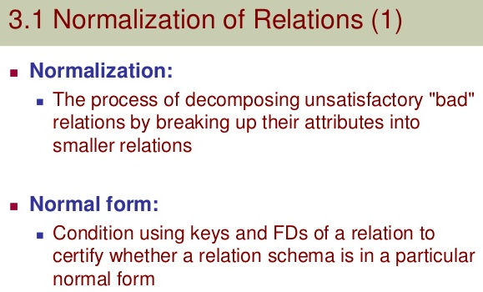
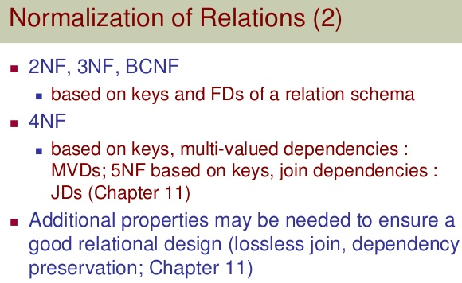
Normalization

Slide 71
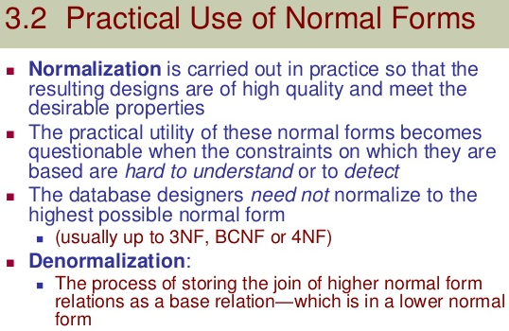
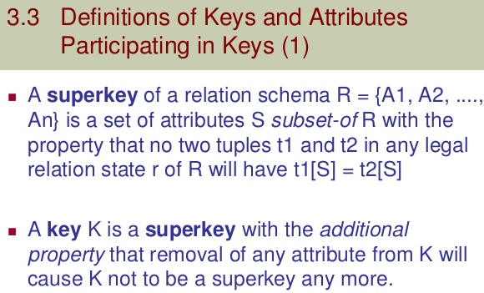
Normalization

Slide 72
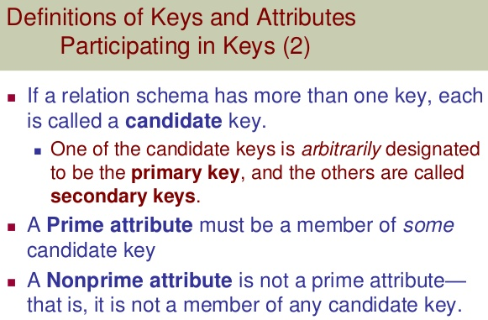
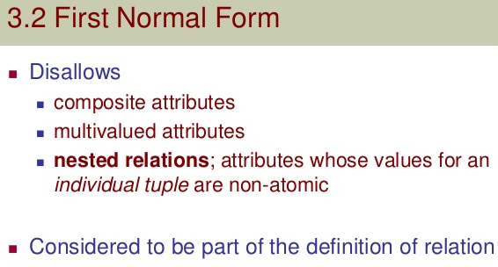
Normalization

Slide 73
1 NF
A relation will be 1NF
If it contains an atomic value.
It states that an attribute of a table cannot hold multiple values.
It must hold only single-valued attribute.
First normal form disallows the multi-valued attribute, composite attribute, and their combinations.
SOLUTION:
The decomposition of the EMPLOYEE table into 1NF has been shown below:
EMP_ID | EMP_NAME | EMP_PHONE | EMP_STATE
14 | John | 7272826385, 9064738238 | UP
20 | Harry | 8574783832 | Bihar
12 | Sam | 7390372389, 8589830302 | Punjab
EMP_ID | EMP_NAME | EMP_PHONE | EMP_STATE
14 | John | 7272826385 | UP
14 | John | 9064738238 | UP
20 | Harry | 8574783832 | Bihar
12 | Sam | 7390372389 | Punjab
12 | Sam | 8589830302 | Punjab
Relation EMPLOYEE is not in 1NF because of multi-valued attribute EMP_PHONE.

Slide 74
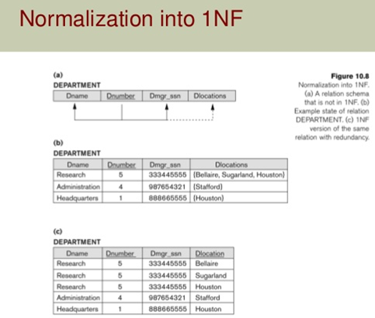
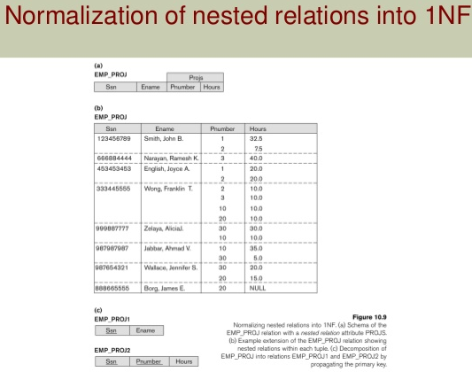
Normalization

Slide 75
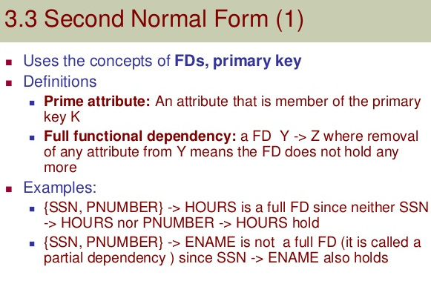
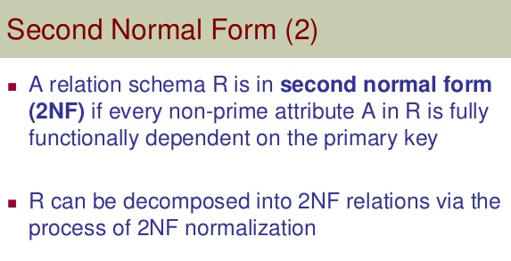
Normalization

Slide 76
2 NF
In the 2NF,
Relational must be in 1NF.
All non-key attributes are fully functional dependent on the primary key
Is the Table in 2NF? In the given table, non-prime attribute TEACHER_AGE is dependent on TEACHER_ID which is a proper subset of a candidate key.
That's why it violates the rule for 2NF.
Example: Let's assume, a school can store the data of teachers and the subjects they teach. In a school, a teacher can teach more than one subject.
TEACHER table
To convert the given table into 2NF, we decompose it into two tables:
TEACHER_ID | SUBJECT | TEACHER_AGE
25 | Chemistry | 30
25 | Biology | 30
47 | English | 35
83 | Math | 38
83 | Computer | 38

Slide 77
2 NF
TEACHER_DETAIL table:
TEACHER_ID | TEACHER_AGE
25 | 30
47 | 35
83 | 38
TEACHER_SUBJECT table:
TEACHER_ID | SUBJECT
25 | Chemistry
25 | Biology
47 | English
83 | Math
83 | Computer

Slide 78
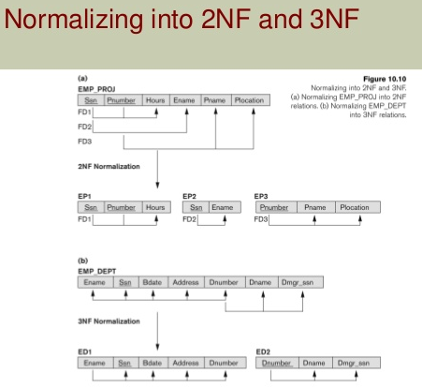
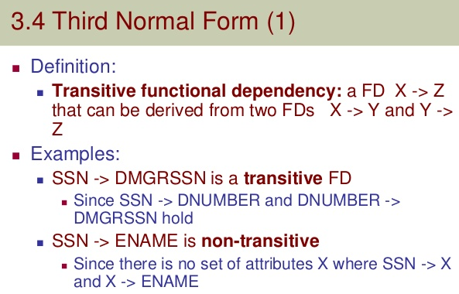
Normalization

Slide 79
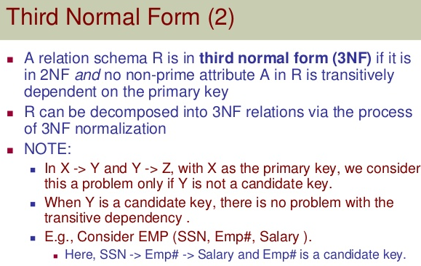
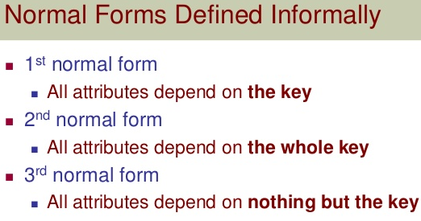
Normalization

Slide 80
3 NF
A relation will be in 3NF
If it is in 2NF and not contain any transitive partial dependency.
3NF is used to reduce the data duplication. It is also used to achieve the data integrity.
If there is no transitive dependency for non-prime attributes, then the relation must be in third normal form.
A relation is in third normal form if it holds at-least one of the following conditions for every non-trivial function dependency X → Y.
X is a super key.
Y is a prime attribute, i.e., each element of Y is part of some candidate key.
EMPLOYEE_DETAIL table:
EMP_ID | EMP_NAME | EMP_ZIP | EMP_STATE | EMP_CITY
222 | Harry | 201010 | UP | Noida
333 | Stephan | 02228 | US | Boston
444 | Lan | 60007 | US | Chicago
555 | Katharine | 06389 | UK | Norwich
666 | John | 462007 | MP | Bhopal
Super key in the table above:
{EMP_ID}, {EMP_ID, EMP_NAME}, {EMP_ID, EMP_NAME, EMP_ZIP}....so on
Candidate key: {EMP_ID}

Slide 81
3 NF
Non-prime attributes: In the given table, all attributes except EMP_ID are non-prime.
Here, EMP_STATE & EMP_CITY dependent on EMP_ZIP and EMP_ZIP dependent on EMP_ID.
Is table in 3NF?
The non-prime attributes (EMP_STATE, EMP_CITY) transitively dependent on super key(EMP_ID). It violates the rule of third normal form.
SOLUTION
That's why we need to move the EMP_CITY and EMP_STATE to the new <EMPLOYEE_ZIP> table, with EMP_ZIP as a Primary key.
EMPLOYEE_ZIP table:
EMPLOYEE table:
EMP_ID | EMP_NAME | EMP_ZIP
222 | Harry | 201010
333 | Stephan | 02228
444 | Lan | 60007
555 | Katharine | 06389
666 | John | 462007
EMP_ZIP | EMP_STATE | EMP_CITY
201010 | UP | Noida
02228 | US | Boston
60007 | US | Chicago
06389 | UK | Norwich
462007 | MP | Bhopal

Slide 82
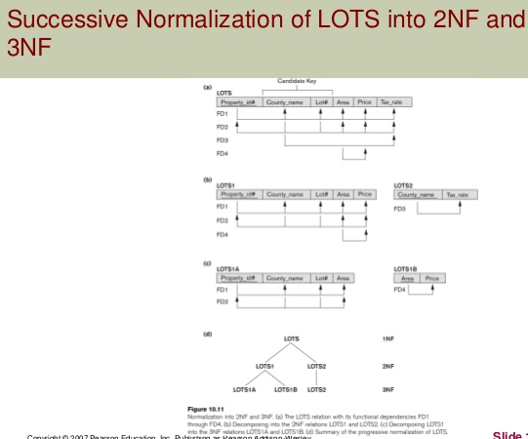
Normalization

Slide 83
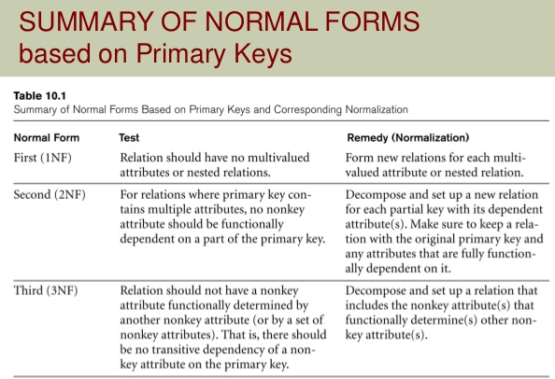
Normalization

Slide 84

Examples
Assume a video library maintains a database of movies rented out. Without any normalization all information is stored in one table as shown below.
UNF :
Here you see Movies Rented column has multiple values and so is category

Slide 85

1NF
1NF (First Normal Form) Rules
Each table cell should contain single value.
Each record needs to be unique.
The above table in 1NF-

Slide 86


2NF
2NF (Second Normal Form) Rules
Rule 1- Be in 1NF
Rule 2- Single Column Primary Key
a new column called Membership_id which is the primary key for table 1. Records can be uniquely identified in Table 1 using membership id

Slide 87


3NF
3NF (ThirdNormal Form) Rules
Rule 1- Be in 2NF
Rule 2- Has no transitive functional dependencies

Slide 88

Exercise

Slide 89

Exercise

Slide 90


3NF ex 2
Consider the following example:
In the table able, [Book ID] determines [Genre ID], and [Genre ID] determines [Genre Type]. Therefore, [Book ID] determines [Genre Type] via [Genre ID] and we have transitive functional dependency, and this structure does not satisfy third normal form.
To bring this table to third normal form, we split the table into two as follows:
By transitive functional dependency, we mean we have the following relationships in the table: A is functionally dependent on B, and B is functionally dependent on C. In this case, C is transitively dependent on A via B.

Slide 91


Normalization

Slide 92

BCNF

Slide 93

BCNF

Slide 94

BCNF

Slide 95

BCNF

Slide 96

BCNF

Slide 97
BCNF ( BOYCE CODD NF)
BCNF is the advance version of 3NF. It is stricter than 3NF.
A table is in BCNF if every functional dependency X → Y, X is the super key of the table.
For BCNF, the table should be in 3NF, and for every FD, LHS is super key.
Example: Let's assume there is a company where employees work in more than one department.
EMPLOYEE table:
EMP_ID | EMP_COUNTRY | EMP_DEPT | DEPT_TYPE | EMP_DEPT_NO
264 | India | Designing | D394 | 283
264 | India | Testing | D394 | 300
364 | UK | Stores | D283 | 232
364 | UK | Developing | D283 | 549
Candidate key:
{EMP-ID, EMP-DEPT}
Is the table in BCNF?
The table is not in BCNF because neither EMP_DEPT nor EMP_ID alone are keys.
In the above table Functional dependencies are as follows:
EMP_ID → EMP_COUNTRY
EMP_DEPT → {DEPT_TYPE, EMP_DEPT_NO}

Slide 98
BCNF ( BOYCE CODD NF)
To convert the given table into BCNF, we decompose it into three tables:
EMP_COUNTRY table:
Functional dependencies:
EMP_ID | EMP_COUNTRY
264 | India
264 | India
EMP_ID → EMP_COUNTRY
EMP_DEPT → {DEPT_TYPE, EMP_DEPT_NO}
EMP_DEPT_MAPPING table:
EMP_ID | EMP_DEPT
D394 | 283
D394 | 300
D283 | 232
D283 | 549
EMP_DEPT table:
EMP_DEPT | DEPT_TYPE | EMP_DEPT_NO
Designing | D394 | 283
Testing | D394 | 300
Stores | D283 | 232
Developing | D283 | 549
Candidate keys:
For the first table: EMP_ID For the second table: EMP_DEPT For the third table: {EMP_ID, EMP_DEPT}
Now, this is in BCNF because left side part of both the functional dependencies is a key.

Slide 99
4NF: MVD
Multivalued dependency occurs when two attributes in a table are independent of each other but, both depend on a third attribute.
A multivalued dependency consists of at least two attributes that are dependent on a third attribute that's why it always requires at least three attributes.
Example: Suppose there is a bike manufacturer company which produces two colors(white and black) of each model every year.
Here columns COLOR and MANUF_YEAR are dependent on BIKE_MODEL and independent of each other.
In this case, these two columns can be called as multivalued dependent on BIKE_MODEL. The representation of these dependencies is shown below:
BIKE_MODEL | MANUF_YEAR | COLOR
M2011 | 2008 | White
M2001 | 2008 | Black
M3001 | 2013 | White
M3001 | 2013 | Black
M4006 | 2017 | White
M4006 | 2017 | Black
BIKE_MODEL → → MANUF_YEAR
BIKE_MODEL → → COLOR
This can be read as "BIKE_MODEL multidetermined MANUF_YEAR" and "BIKE_MODEL multidetermined COLOR".

Slide 100
4NF
A relation will be in 4NF
if it is in Boyce Codd normal form and has no multi-valued dependency.
For a dependency A → B, if for a single value of A, multiple values of B exists, then the relation will be a multi-valued dependency.
Example
STUDENT
Is the table in 4NF?
The given STUDENT table is in 3NF, but the COURSE and HOBBY are two independent entity. Hence, there is no relationship between COURSE and HOBBY.
In the STUDENT relation, a student with STU_ID, 21 contains two courses, Computer and Math and two hobbies, Dancing and Singing. So there is a Multi-valued dependency on STU_ID, which leads to unnecessary repetition of data.
STU_ID | COURSE | HOBBY
21 | Computer | Dancing
21 | Math | Singing
34 | Chemistry | Dancing
74 | Biology | Cricket
59 | Physics | Hockey

Slide 101
4NF
So to make the above table into 4NF, we can decompose it into two tables:
STUDENT_COURSE
STUDENT_HOBBY
STU_ID | COURSE
21 | Computer
21 | Math
34 | Chemistry
74 | Biology
59 | Physics
STU_ID | HOBBY
21 | Dancing
21 | Singing
34 | Dancing
74 | Cricket
59 | Hockey

Slide 102



Multivalued dependency (MVD)

Slide 103

MVD
Definition. A multivalued dependency X Y specified on relation schema R,
where X and Y are both subsets of R, specifies the following constraint on any
relation state r of R: If two tuples t1 and t2 exist in r such that t1[X] = t2[X], then
two tuples t3 and t4 should also exist in r with the following properties, where
we use Z to denote (R – (X ∪ Y))
■ t3[X] = t4[X] = t1[X] = t2[X].
■ t3[Y] = t1[Y] and t4[Y] = t2[Y].
■ t3[Z] = t2[Z] and t4[Z] = t1[Z].
Whenever X Y holds, we say that X multidetermines Y. Because of the symmetry
in the definition, whenever X Y holds in R, so does X Z. Hence, X Y
implies X Z, and therefore it is sometimes written as X Y|Z.

Slide 104
Example MVD
Course ->> Instructor
Course ->> Text
Course(Y) | Instructor(X) | Text(R-XY)
Intro | Kruse | Intro to CS
Intro | Wright | Intro to CS
CS1 | Thomas | Intro to Java
CS1 | Thomas | CS Theory Survey
CS2 | Rhodes | Java Data Structures
CS2 | Rhodes | Unix
CS2 | Kruse | Java Data Structures
CS2 | Kruse | Unix

Slide 105
4th Normal Form
An entity is in Fourth Normal Form (4NF)
when it meets the requirement of being in BCNF
and additionally:
Has no multiple sets of multi-valued dependencies.
In other words, 4NF states that no entity can have more than a
single one-to-many relationship within an entity if the one-to-many
attributes are independent of each other.
Many:many relationships are resolved independently

Slide 106

Example

Slide 107
Example 4NF
A relation R is in 4NF if for all MVD in D+ of the form A->>B at least one of the following hold
A ->> B is a trivial MVD
A is a superkey
Course(Y) | Instructor(X) | Text(R-XY)
Intro | Kruse | Intro to CS
Intro | Wright | Intro to CS
CS1 | Thomas | Intro to Java
CS1 | Thomas | CS Theory Survey
CS2 | Rhodes | Java Data Structures
CS2 | Rhodes | Unix
CS2 | Kruse | Java Data Structures
CS2 | Kruse | Unix
Above example is not 4NF.
Therefore decompose it as (Course, Instructor) and (Course, Text)
Which is 4NF decomposition.

Slide 108
5th Normal form

Slide 109
5NF
A relation is in 5NF
if it is in 4NF and not contains any join dependency and joining should be lossless.
5NF is satisfied when all the tables are broken into as many tables as possible in order to avoid redundancy.
5NF is also known as Project-join normal form (PJ/NF).
Is the table in 5NF? NO its not!
In the above table, John takes both Computer and Math class for Semester 1 but he doesn't take Math class for Semester 2.
In this case, combination of all these fields required to identify a valid data.
Suppose we add a new Semester as Semester 3 but do not know about the subject and who will be taking that subject so we leave Lecturer and Subject as NULL. But all three columns together acts as a primary key, so we can't leave other two columns blank.
SUBJECT | LECTURER | SEMESTER
Computer | Anshika | Semester 1
Computer | John | Semester 1
Math | John | Semester 1
Math | Akash | Semester 2
Chemistry | Praveen | Semester 1

Slide 110
5NF
So to make the above table into 5NF, we can decompose it into three relations P1, P2 & P3:
P1
P3
SEMESTER | SUBJECT
Semester 1 | Computer
Semester 1 | Math
Semester 1 | Chemistry
Semester 2 | Math
SEMSTER | LECTURER
Semester 1 | Anshika
Semester 1 | John
Semester 1 | John
Semester 2 | Akash
Semester 1 | Praveen
SUBJECT | LECTURER
Computer | Anshika
Computer | John
Math | John
Math | Akash
Chemistry | Praveen
P2

Slide 111

5th Normal form
An entity is in Fifth Normal Form (5NF) if, and only if, it is in 4NF and every join dependency for the entity is a consequence of its candidate keys.
Definition. A join dependency (JD), denoted by JD(R1, R2, ..., Rn), specified on
relation schema R, specifies a constraint on the states r of R. The constraint
states that every legal state r of R should have a non additive join decomposition
into R1, R2, ..., Rn. Hence, for every such r we have

Slide 112
5NF ?
-> Must be in 4NF.
-> if JD doesn’t exist then its in 5NF.
-> if JD exists then check if trivialJD then in 5NF
else if (all Ri is superkey) then 5NF
else its not in 5NF.
R-> (R1, R2, ..,Rn)

Slide 113


Example 5NF

Slide 114

5NF
Definition. A relation schema R is in fifth normal form (5NF) (or project-join
normal form (PJNF)) with respect to a set F of functional, multivalued, and
join dependencies if, for every nontrivial join dependency JD(R1, R2, ..., Rn) in
F+ (that is, implied by F), every Ri is a superkey of R.

Slide 115
Decomposition
Let R be a relation schema
A set of relation schemas { R1, R2,…, Rn } is a decomposition of R if
R = R1 U R2 U …..U Rn
each Ri is a subset of R ( for i = 1,2…,n)
For relation R(x,y,z) there can be 2 subsets: R1(x,z) and R2(y,z)
If we union R1 and R2, we get R = R1 U R2
Goal of Decomposition
Eliminate redundancy by decomposing a relation into several relations in a higher normal form.
It is important to check that a decomposition does not lead to bad design
Problem with Decomposition
Given instances of the decomposed relations, we may not be able to reconstruct the corresponding instance of
the original relation – information loss
Example of Decomposition

Slide 116
Example : Problem with Decomposition
R
Model Name | Price | Category
a11 | 100 | Canon
s20 | 200 | Nikon
a70 | 150 | Canon
R1
R2
Model Name | Category
a11 | Canon
s20 | Nikon
a70 | Canon
Price | Category
100 | Canon
200 | Nikon
150 | Canon

Slide 117
Example : Problem with Decomposition
Model Name | Price | Category
a11 | 100 | Canon
a11 | 150 | Canon
s20 | 200 | Nikon
a70 | 100 | Canon
a70 | 150 | Canon
R1 U R2
Model Name | Price | Category
a11 | 100 | Canon
s20 | 200 | Nikon
a70 | 150 | Canon
R

Slide 118
Lossy decomposition or Additive JD
In previous example, additional tuples are obtained along with original tuples
Although there are more tuples, this leads to less information
Due to the loss of information, decomposition for previous example is called lossy decomposition or lossy-join decomposition
T
Employee | Project | Branch
Brown | Mars | L.A.
Green | Jupiter | San Jose
Green | Venus | San Jose
Hoskins | Saturn | San Jose
Hoskins | Venus | San Jose
Functional dependencies:
Employee Branch, Project Branch

Slide 119
Lossy decomposition or Additive JD
Decomposition of the previous relation
T1
T2
Employee | Branch
Brown | L.A
Green | San Jose
Hoskins | San Jose
Project | Branch
Mars | L.A.
Jupiter | San Jose
Saturn | San Jose
Venus | San Jose

Slide 120
Lossy decomposition or Additive JD
After Natural Join
Employee | Project | Branch
Brown | Mars | L.A.
Green | Jupiter | San Jose
Green | Venus | San Jose
Hoskins | Saturn | San Jose
Hoskins | Venus | San Jose
Green | Saturn | San Jose
Hoskins | Jupiter | San Jose
Original Relation
Employee | Project | Branch
Brown | Mars | L.A.
Green | Jupiter | San Jose
Green | Venus | San Jose
Hoskins | Saturn | San Jose
Hoskins | Venus | San Jose
After Natural Join, we get two extra tuples. Thus, there is loss of information

Slide 121
Lossless Decomposition or NonAdditive JD
A decomposition {R1, R2,…, Rn} of a relation R is called a lossless decomposition for R if the natural join of R1, R2,…, Rn produces exactly the relation R.
A decomposition is lossless if we can recover:
R(A, B, C)
Decompose
R1(A, B) R2(A, C)
Recover
R’(A, B, C)
Thus, R’ = R

Slide 122
Lossless Decomposition Property
R : relation
F : set of functional dependencies on R
X,Y : decomposition of R
Decomposition is lossles if :
X ∩ Y → X, that is: all attributes common to both X and Y functionally determine ALL the attributes in X OR
X ∩ Y → Y, that is: all attributes common to both X and Y functionally determine ALL the attributes in Y
In other words, if X ∩ Y forms a superkey of either X or Y, the decomposition of R is a lossless decomposition

Slide 123
Example : Lossless Decomposition
Given:
Lending-schema = (branch-name, branch-city, assets, customer-name, loan-number, amount)
Required FD’s:
branch-name branch-city assets
loan-number amount branch-name
Decompose Lending-schema into two schemas:
Branch-schema = (branch-name, branch-city, assets)
Loan-info-schema = (branch-name, customer-name, loan-number, amount)
Show that decomposition is Lossless Decomposition
Since branch-name branch-city assets, the augmentation rule for FD implies that:
branch-name branch-name branch-city assets
Since Branch-schema ∩ Loan-info-schema = {branch-name}
Thus, this decomposition is Lossless decomposition

Slide 124
Lossless Decomposition
If the information is not lost from the relation that is decomposed, then the decomposition will be lossless.
The lossless decomposition guarantees that the join of relations will result in the same relation as it was decomposed.
The relation is said to be lossless decomposition if natural joins of all the decomposition give the original relation.
EMPLOYEE_DEPARTMENT table:
EMP_ID | EMP_NAME | EMP_AGE | EMP_CITY | DEPT_ID | DEPT_NAME
22 | Denim | 28 | Mumbai | 827 | Sales
33 | Alina | 25 | Delhi | 438 | Marketing
46 | Stephan | 30 | Bangalore | 869 | Finance
52 | Katherine | 36 | Mumbai | 575 | Production
60 | Jack | 40 | Noida | 678 | Testing

Slide 125
Lossless Decomposition
The above relation is decomposed into two relations EMPLOYEE and DEPARTMENT
EMP_ID | EMP_NAME | EMP_AGE | EMP_CITY
22 | Denim | 28 | Mumbai
33 | Alina | 25 | Delhi
46 | Stephan | 30 | Bangalore
52 | Katherine | 36 | Mumbai
60 | Jack | 40 | Noida
Employee
Hence, the decomposition is Lossless join decomposition.
Employee ⋈ Department
Department
EMP_ID | EMP_NAME | EMP_AGE | EMP_CITY | DEPT_ID | DEPT_NAME
22 | Denim | 28 | Mumbai | 827 | Sales
33 | Alina | 25 | Delhi | 438 | Marketing
46 | Stephan | 30 | Bangalore | 869 | Finance
52 | Katherine | 36 | Mumbai | 575 | Production
60 | Jack | 40 | Noida | 678 | Testing
DEPT_ID | EMP_ID | DEPT_NAME
827 | 22 | Sales
438 | 33 | Marketing
869 | 46 | Finance
575 | 52 | Production
678 | 60 | Testing

Slide 126

Testing for Lossless NonAdditive Join

Slide 127
Example :
Explain Is it Lossy or lossless join decomposition in the following relation
R(A, B,C,D,E) and F={ A->B, B->C, D->C, D->E} Where R is decomposed
into R1(A,B,D) and R2(C,D,E) ?
Solution:
A B C D E
A B C D E
Therefore LOSSLESS JD.
R1
D | D | D | D | D
 |  | D | D | D
R2

Slide 128
Conclusions
Decompositions should always be lossless.
Lossless decomposition ensure that the information in the original relation can be accurately reconstructed based on the information represented in the decomposed relations.

Slide 129
Tutorial Session
Redundant storage: Some information is stored repeatedly.
Update anomalies: If one copy of such repeated data is updated, an inconsistency is created unless all copies are similarly updated.
Insertion anomalies: It may not be possible to store some information unless some other information is stored as well.
Deletion anomalies: It may not be possible to delete some information without losing some other information as well
S_id | S_Name | S_Address | Subject_opted
401 | Adam | Noida | Bio
402 | Alex | Panipat | Maths
403 | Stuart | Jammu | Maths
404 | Adam | Noida | Physics
Updation Anamoly : To update address of a student who occurs twice or more than twice in a table, we will have to update S_Address column in all the rows, else data will become inconsistent.
Insertion Anamoly : Suppose for a new admission, we have a Student id(S_id), name and address of a student but if student has not opted for any subjects yet then we have to insert NULL there, leading to Insertion Anamoly.
Deletion Anamoly : If (S_id) 401 has only one subject and temporarily he drops it, when we delete that row, entire student record will be deleted along with it.
All because of redundant data.
We use DECOMPOSITION, NORMALIZATION to eliminate redundancy and anomalies due to redundancy.

Slide 130
THANK YOU

